Slide 1
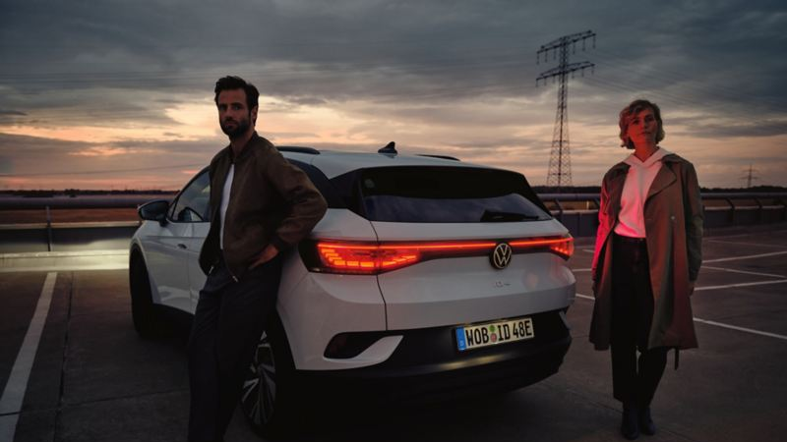



ID audience targeting | 23 May 24’
ID. Series
Audience Targeting
x
23 May 24’ | ID audience targeting

Slide 2
Brief recap

Slide 3
Phase one
Objective
Develop a point of view on whether there are one or more environments (either physical or digital) in which those predisposed to purchase both electric vehicles and Volkswagen overlap
Tasks
Analysis of latest EV council data
Refresh VW data extracts from SFMC
ETL into existing proof of concept underlying data cube
Update the dashboards and creation of visualisation for each state capital
Preparation of PDF outputs
Outputs
PDF outputs of the Tableau dashboard including:
Visualisation of each state capital at the post code level for each metric contributing to the propensity metric
The propensity metric
A list of the top suburbs and their propensity scores in excel
Annotated commentary and recommendations by strategy
3

Slide 4
Set up

Slide 5
What do we mean by propensity?
Throughout this work we use the term propensity to denote ‘the modelled “likelihood” of a customer to purchase a vehicle from the ID series’ ¹
Total vehicles in postcode
Past VW ownership ²
ID.4 and ID.5 RYIs ³
ID. Series propensity
EV pen. ²
x
x
x
=
Propensity is calculated at the postcode level – the lowest level of granularity available to us (to maximise the value of targeting) whilst leveraging free, publicly available datasets, and ensuring coverage beyond Volkswagen’s known audience.
No consideration has been made to distinguish buyers of these two EPVs
Expressed as a % of total light vehicles on the road
Expressed per 100,000 light vehicles

Slide 6
Data sources
VW Ownership
578,000 past and present owners
VGA Salesforce
% of total light vehicle owners
Electric vehicle registrations
Tesla and BYD sales in 2023
EV Council (publicly available)
% of total light vehicle owners
ID Series RYIs
5,600 ID.4 and ID.5 RYIs
VGA Salesforce (via form on website)

Slide 7
What’s changed since our PoC?
All valid EV registrations as of Jan 2023
Tesla and BYD sales in 2023
All past and present VW owners
All past and present VW owners since the start of 2017
No change ¹
Total Light Vehicle registrations as of Jan 2023
Propensity is based purely on postcode’s “likelihood”
Propensity is based on ”likelihood” and size
(1) Assumed negligible change in the Total Light Vehicles in each post code

Slide 8
Analysis
Which cities should we focus on for launch?

Slide 9
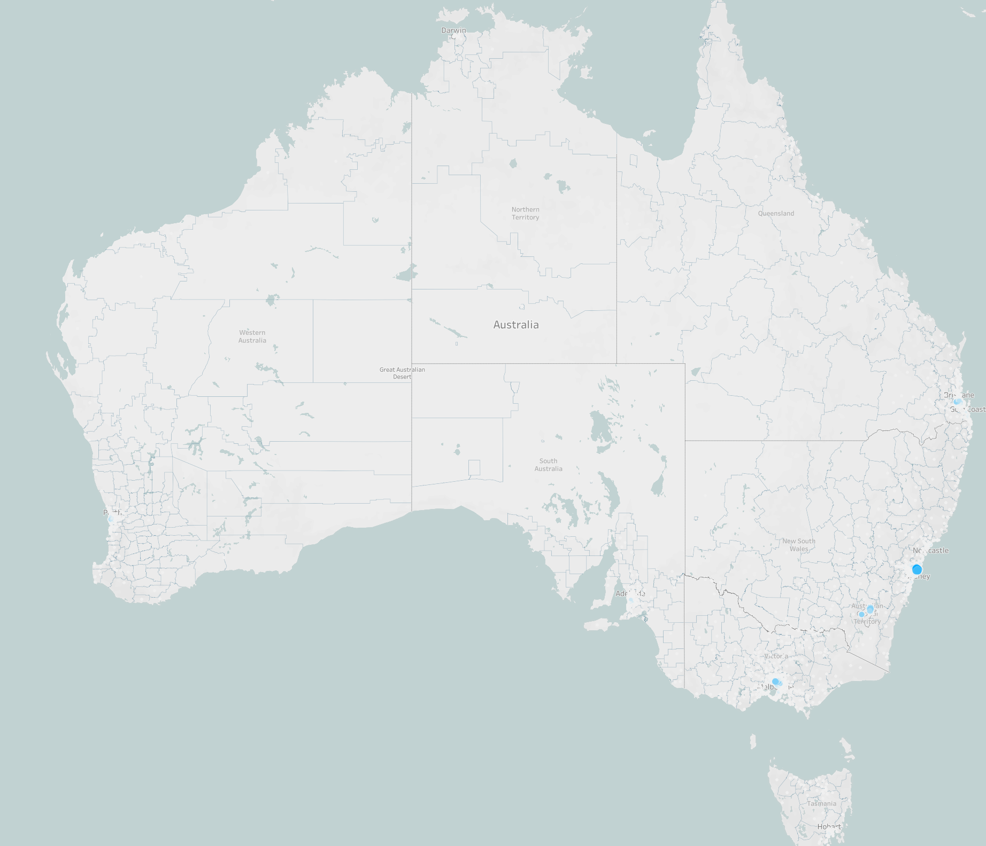
ID. Series propensity hotspots are focussed in Australia’s largest metro areas
Whilst all components of the propensity metric followed this urban centricity, it was the EV% that was most skewed towards urban areas

Slide 10
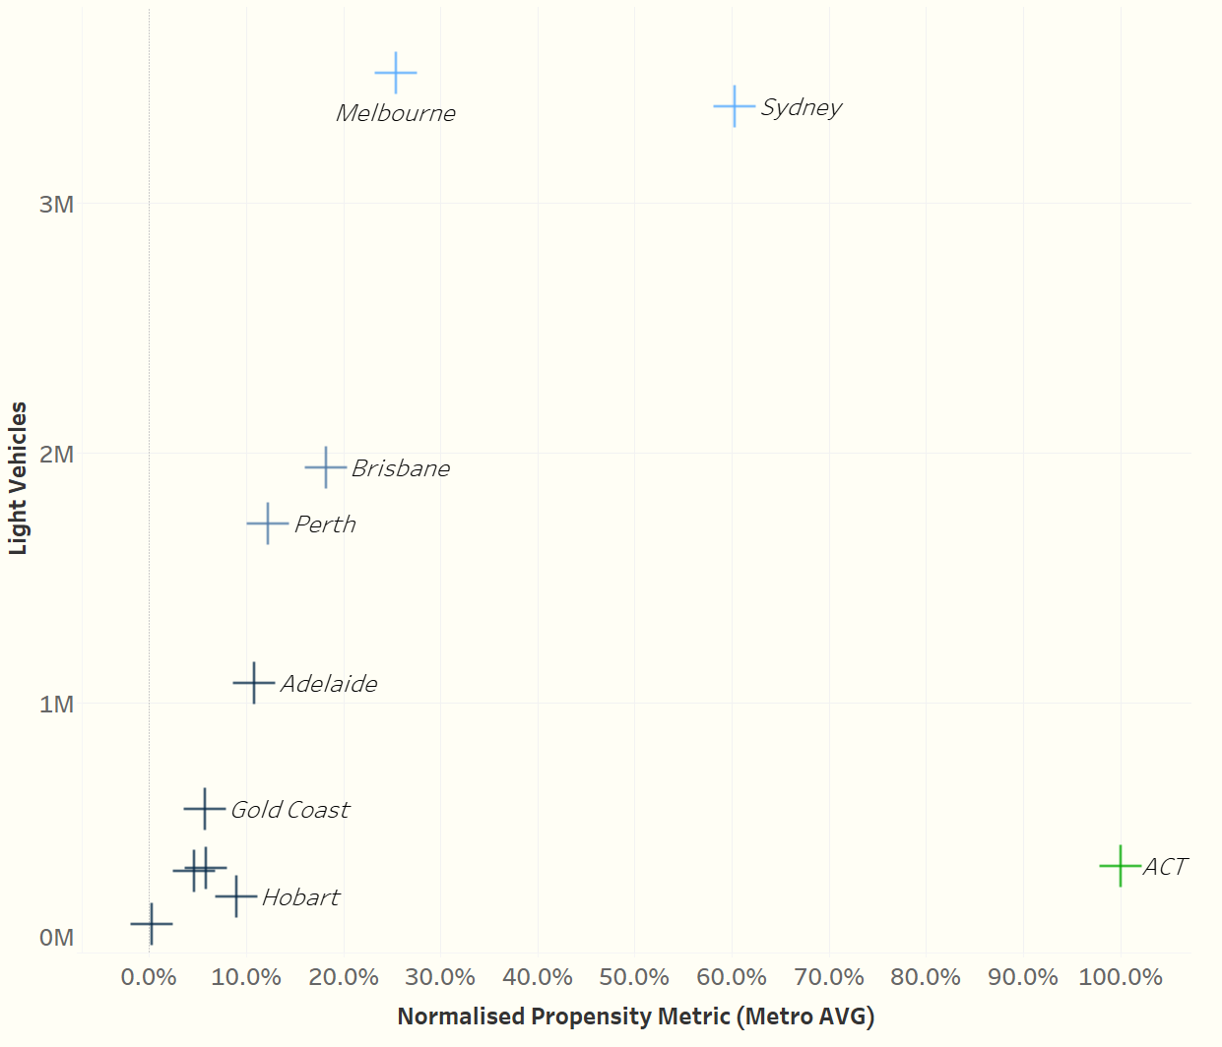
Sydney, Melbourne and Canberra represent the markets with the most significant opportunity
Canberra has by far the largest very high EV affinity though opportunity is constrained by market size.
Sydney and Melbourne are the largest urban centres, and Sydney had the second highest average propensity towards the ID. Series.
Brisbane and Perth would be the ‘next best’ cities in terms of both propensity and addressable audience.

Slide 11
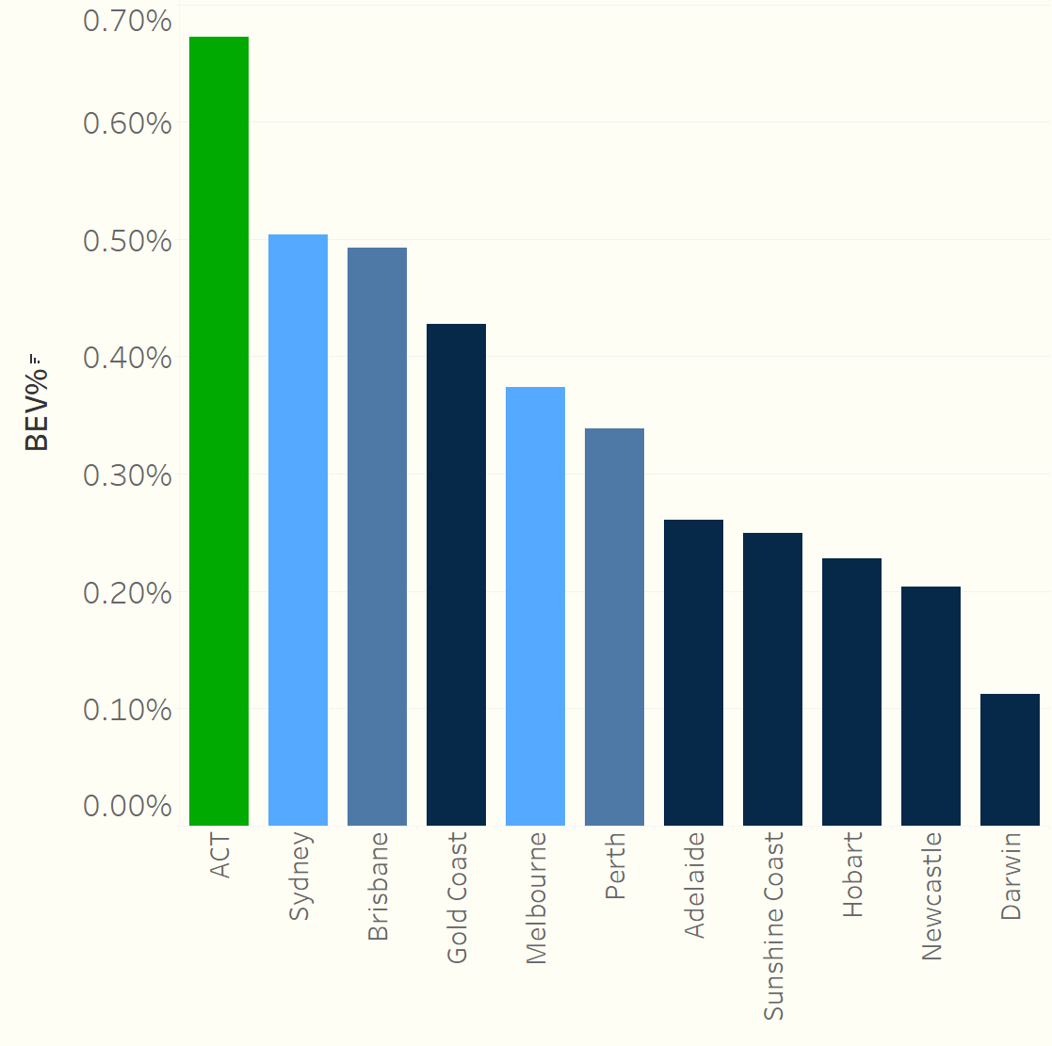
EV penetration: Most of the smaller cities lag behind in terms of their pace of electrification
Canberra led the way in terms of EV uptake in 2023, with Sydney and Brisbane leading the larger cities
Melbourne and Perth demonstrated a slower pace of electrification, but outperformed smaller cities like Hobart and Darwin

Slide 12
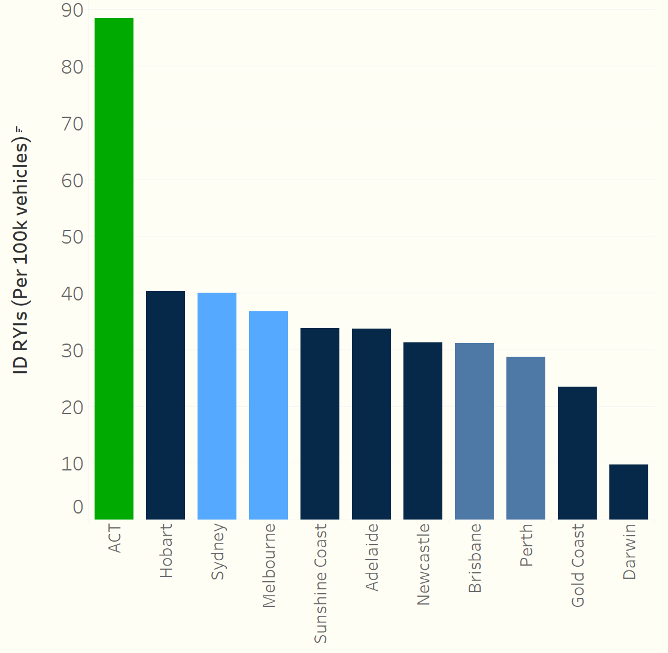
RYIs: ID. series RYI density in Canberra was more than twice that of the next city
Brisbane, Perth and the Gold Coast had relatively lower interest in the ID. series
High interest density in Hobart might be explained by the sensitivity of the metric in the case of the smaller cities

Slide 13
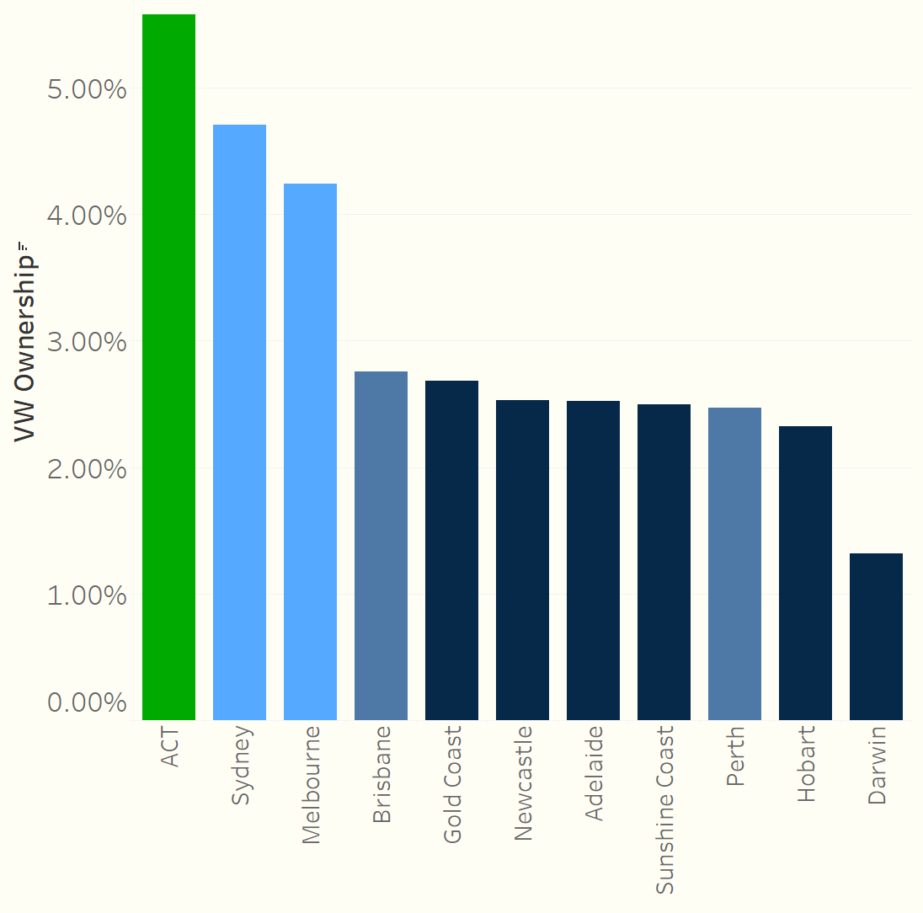
VW Owners: Canberra, Sydney and Melbourne showed much higher density of past/present VW ownership
Again Canberra has a higher rate of VW ownership vs the other
Melbourne and Perth demonstrated a slower pace of electrification, but outperformed smaller cities like Hobart and Darwin

Slide 14
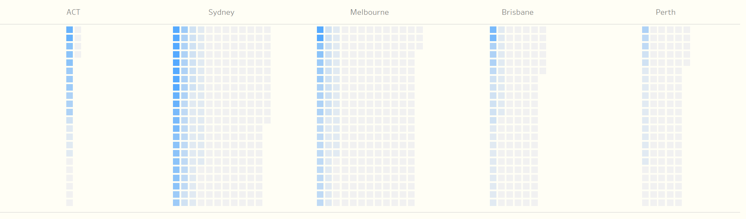
Propensity scoring at postcode level demonstrates the benefits of a targeted approach, particularly in Sydney and Melbourne

Slide 15
Analysis
Within each city, where are the pockets of high propensity?

Slide 16
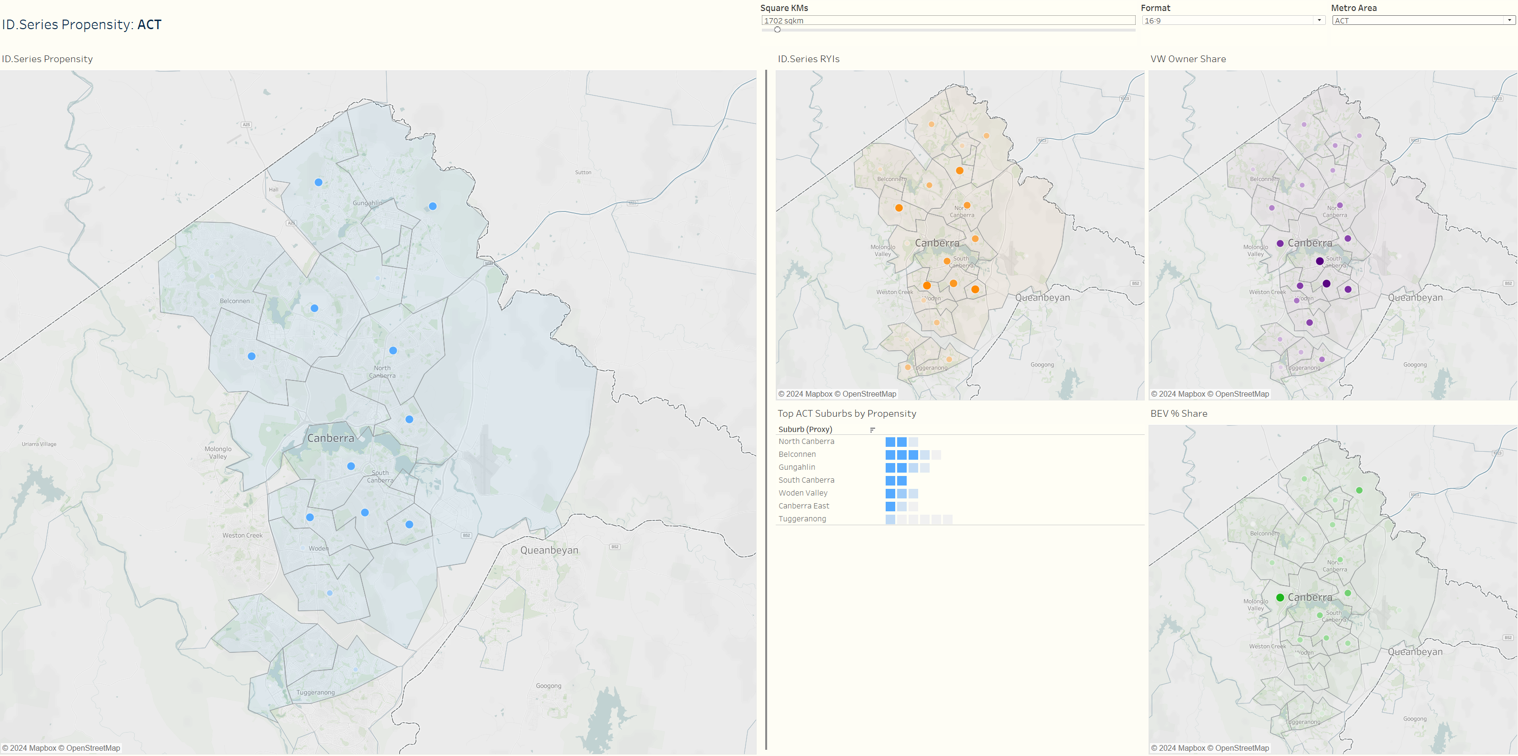
ACT >

Slide 17
ACT: Key Takeaways
Drivers of propensity show different distributions across the ACT:
EV penetration highest in Gunaghlin, East Canberra
VW ownership highest in South Canberra
Results in an even, high propensity distributed right across ACT, and given fewer than 500k vehicles on the road, Canberra represents a cost-effective opportunity market for VW EVs

Slide 18
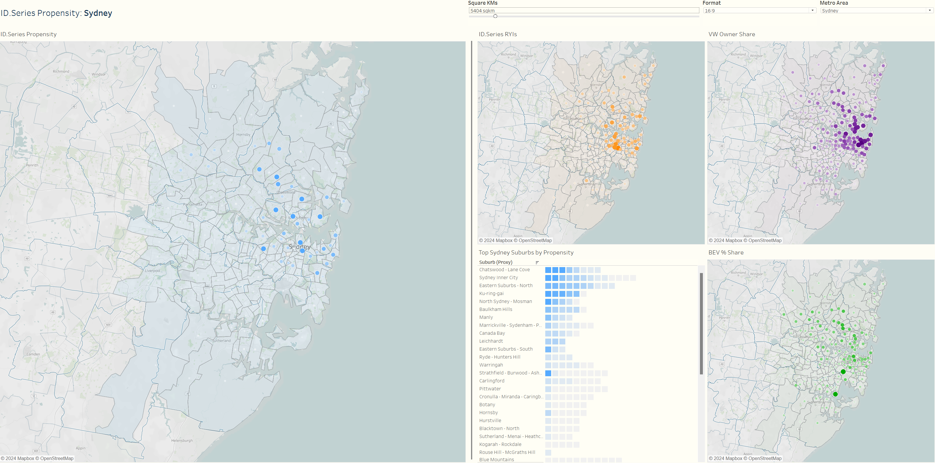
Sydney >

Slide 19
Sydney: Key Takeaways
Highest propensity post codes found in the (North) Eastern Suburbs, the North Shore and the near Inner West
Some suburbs in The Hills and Hornsby had high EV uptake and might also be worth targeting given their relative state of EV readiness
Suggests Northern Beaches, and the Southern and Western regions of Sydney might not be ideal targets for the ID. series.

Slide 20
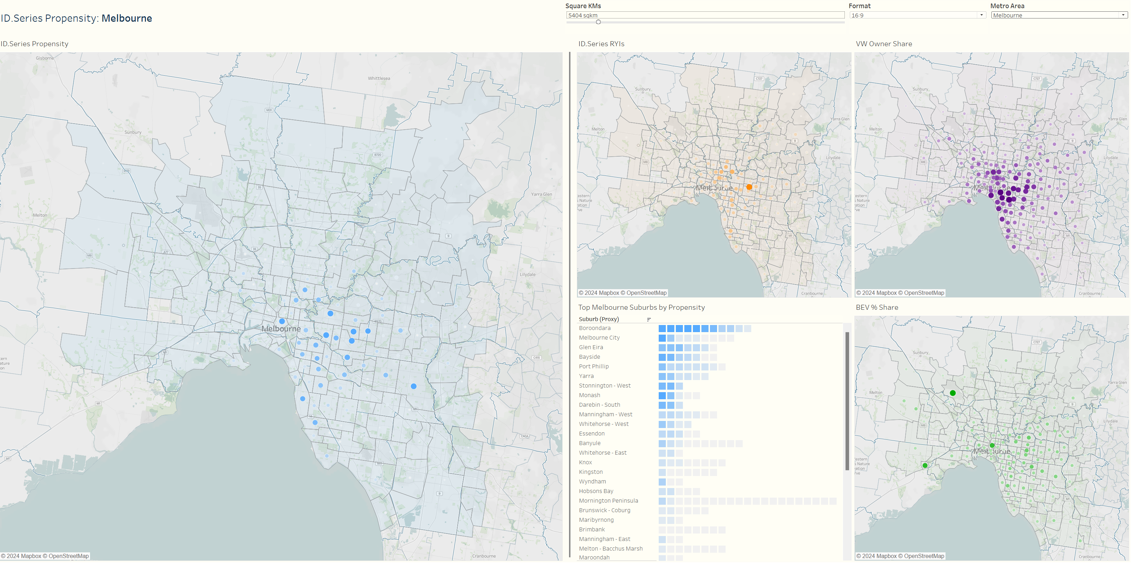
Melbourne >

Slide 21
Melbourne: Key Takeaways
Whilst Melbourne’s average propensity for the ID. series was fairly low, there were hotspots of high propensity worth investing in
Principally, these could be found in the wealthy Eastern suburbs – such as Kew, Hawthorn, Camberwell, Toorak and Brighton
Interestingly the distribution of VW owners and RYIs was very tight within these regions, but EV ownership sprawls more broadly (though still skewing east of the CBD)

Slide 22
Outputs and Next steps

Slide 23
Tier 1 target postcodes (50%+)
Postcode | City | Suburb | Relative propensity
Tier 1
2066 | Sydney | Lane Cove | 100%
2088 | Sydney | Mosman | 95%
2065 | Sydney | St Leonards/Greenwich | 76%
2000 | Sydney | CBD/Haymarket | 69%
2023 | Sydney | Bellevue Hill | 67%
2030 | Sydney | Vaucluse | 65%
3126 | Melbourne | Canterbury | 64%
2071 | Sydney | Killara | 58%
2045 | Sydney | Haberfield | 57%
2068 | Sydney | N. Willoughby | 57%
2602 | Canberra | Downer | 57%
2010 | Sydney | Surry Hills | 51%
2041 | Sydney | Balmain | 50%
Large volume of RYIs
High rate of VW ownership
Possibly an outlier on EV penetration (3.5%)

Slide 24
Tier 2 target postcodes
Postcode | City | Suburb | Relative propensity
Tier 2
3142 | Melbourne | Toorak | 48%
2021 | Sydney | Paddington | 48%
2026 | Sydney | Bondi | 48%
3101 | Melbourne | Kew | 46%
3122 | Melbourne | Hawthorn | 46%
2603 | ACT | Griffith | 45%
2073 | Sydney | West Pymble | 44%
2611 | ACT | Weston Creek | 42%
2031 | Sydney | Randwick | 42%
2605 | ACT | Woden | 42%
2024 | Sydney | Bronte | 42%
2600 | ACT | Barton/Deakin | 42%
4065 | Brisbane | Bardon | 41%
2110 | Sydney | Hunters Hill | 41%
4069 | Brisbane | Kenmore | 40%
Postcode | City | Suburb | Relative propensity
Tier 2 cont.
2070 | Sydney | Lindfield | 40%
3000 | Melbourne | CBD | 38%
3186 | Melbourne | Brighton | 38%
2025 | Sydney | Woollahra | 36%
3124 | Melbourne | Camberwell | 36%
2060 | Sydney | North Sydney | 35%
2612 | ACT | Turner/Campbell | 35%
2074 | Sydney | Turramurra | 34%
2093 | Sydney | Balgowlah | 34%
2075 | Sydney | St Ives | 34%
2604 | ACT | Kingston | 33%
3121 | Melbourne | Richmond | 32%
2015 | Sydney | Alexandria | 31%
3143 | Melbourne | Armadale | 31%
2614 | ACT | Belconnen | 30%

Slide 25

Top postcodes to target beyond top 3 cities (if the strategic opportunity arose)
Postcode | Suburb | Relative propensity
Adelaide
5061 | Unley | 19%
5000 | Inner City | 18%
5062 | Mitcham | 14%
5152 | Stirling | 13%
Perth
6010 | Claremont | 29%
6009 | Nedlands | 20%
6008 | Subiaco | 19%
6153 | Applecross | 17%
Hobart
7004 | Battery Point | 11%
7005 | Sandy Bay | 11%
Postcode | Suburb | Relative propensity
Brisbane
4065 | Bardon | 41%
4069 | Kenmore | 40%
4068 | Indooroopilly | 25%
4152 | Camp Hill | 19%
4000 | Inner City | 18%
We will share the full list of propensity scores by postcode in an Excel

Slide 26
Evolving Phase 1
Consistent, consolidated data on EV ownership (and growth over time)
Mapping VW dealerships to highlight those in suburbs with higher EV propensity
Sensitivity analysis and evolution of propensity score
Leverage EV Sales data within the group (Audi e-tron, CUPRA Born)

Slide 27
Recommendations
Next steps
Target media spending by propensity tier
Media spending – driving RYIs,
Targeting CRM campaigns
Inform local area dealer marketing
Overlay to EV signal retargeting
Collaboration session with Phd
Phase 2 approval and schedule workshop

Slide 28
Opportunities to level up in Phase 2
Propensity to purchase an ID. series vehicle
Financing
EV Openness
EV infrastructure
VGA Connection
Psychographics
Past ownership
Lease/ finance agreement status
Credit score
Dwelling type
3 phase power
Local charging facilities
Solar panel ownership
Life stage / style
EV penetration locally
Attitudes
VW marque fit
ID Journey Stage
ID RYIs
Test drives
Engagement
VGA Ownership history
Garage composition
Demographics

Slide 29
Appendices
METRO AREA DASHBOARDS

Slide 30
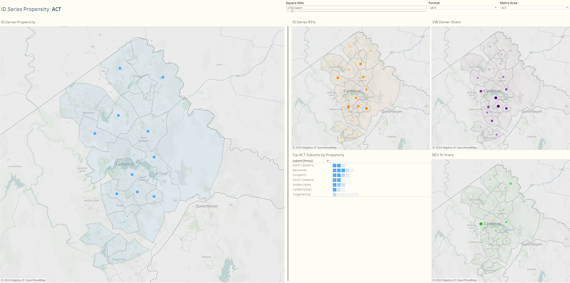
ACT
N.B. All scales represent positive relationship between size/color intensity and metric. For individual metro areas, scales are relative to other suburbs in the same metro area only

Slide 31
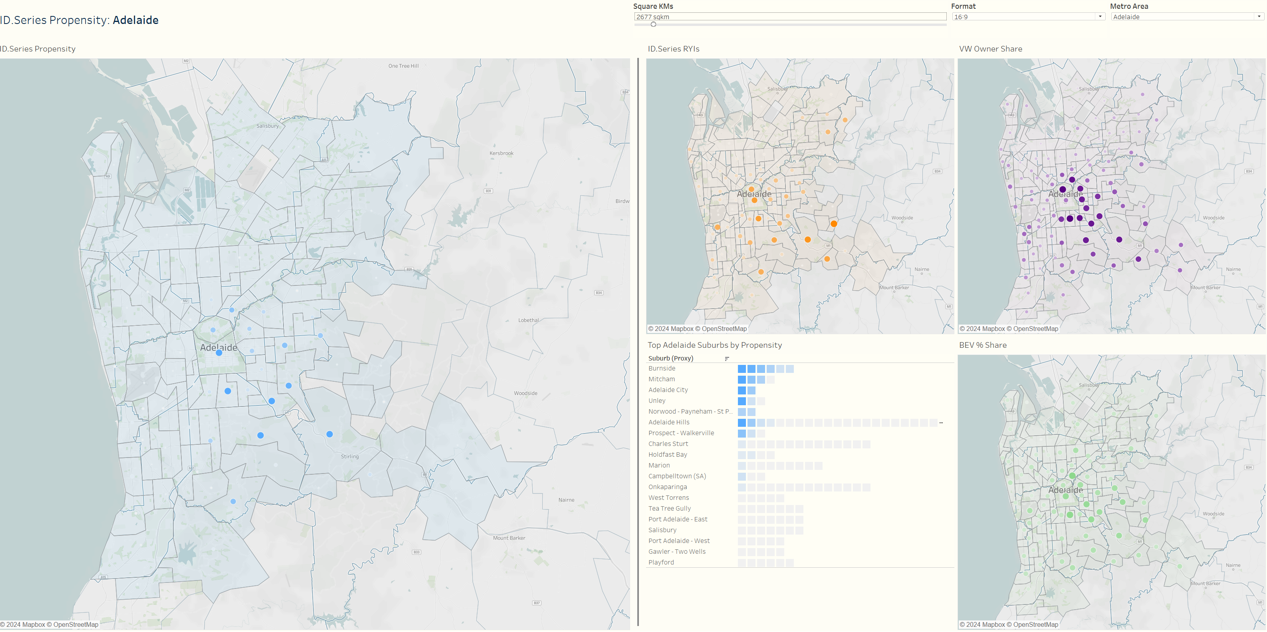
Adelaide
N.B. All scales represent positive relationship between size/color intensity and metric. For individual metro areas, scales are relative to other suburbs in the same metro area only

Slide 32
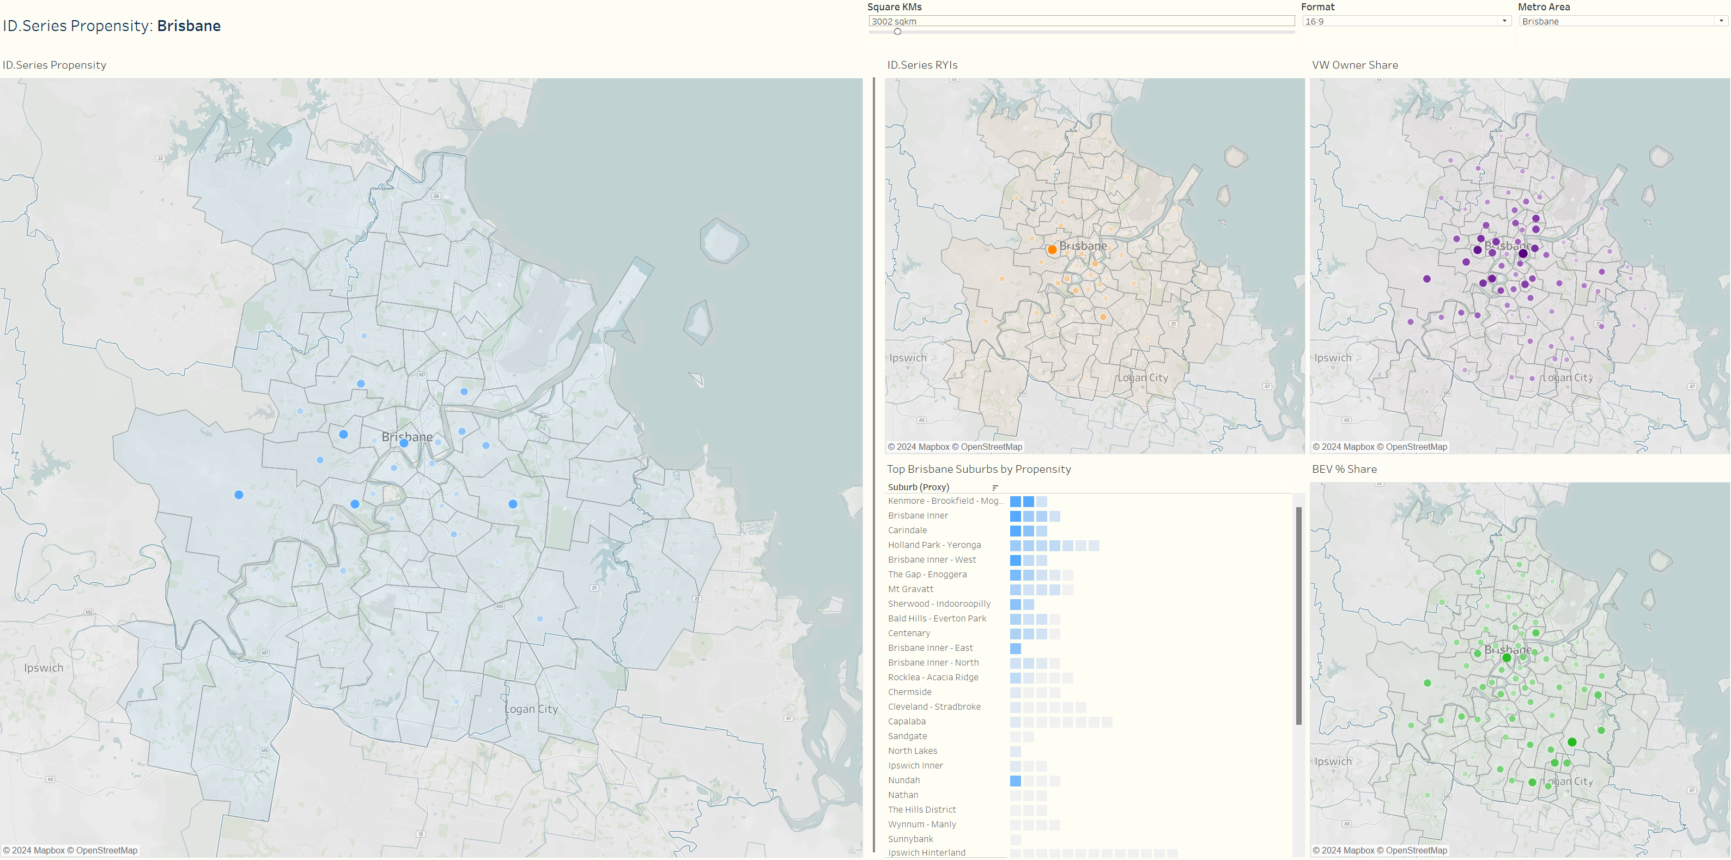
Brisbane
N.B. All scales represent positive relationship between size/color intensity and metric. For individual metro areas, scales are relative to other suburbs in the same metro area only

Slide 33
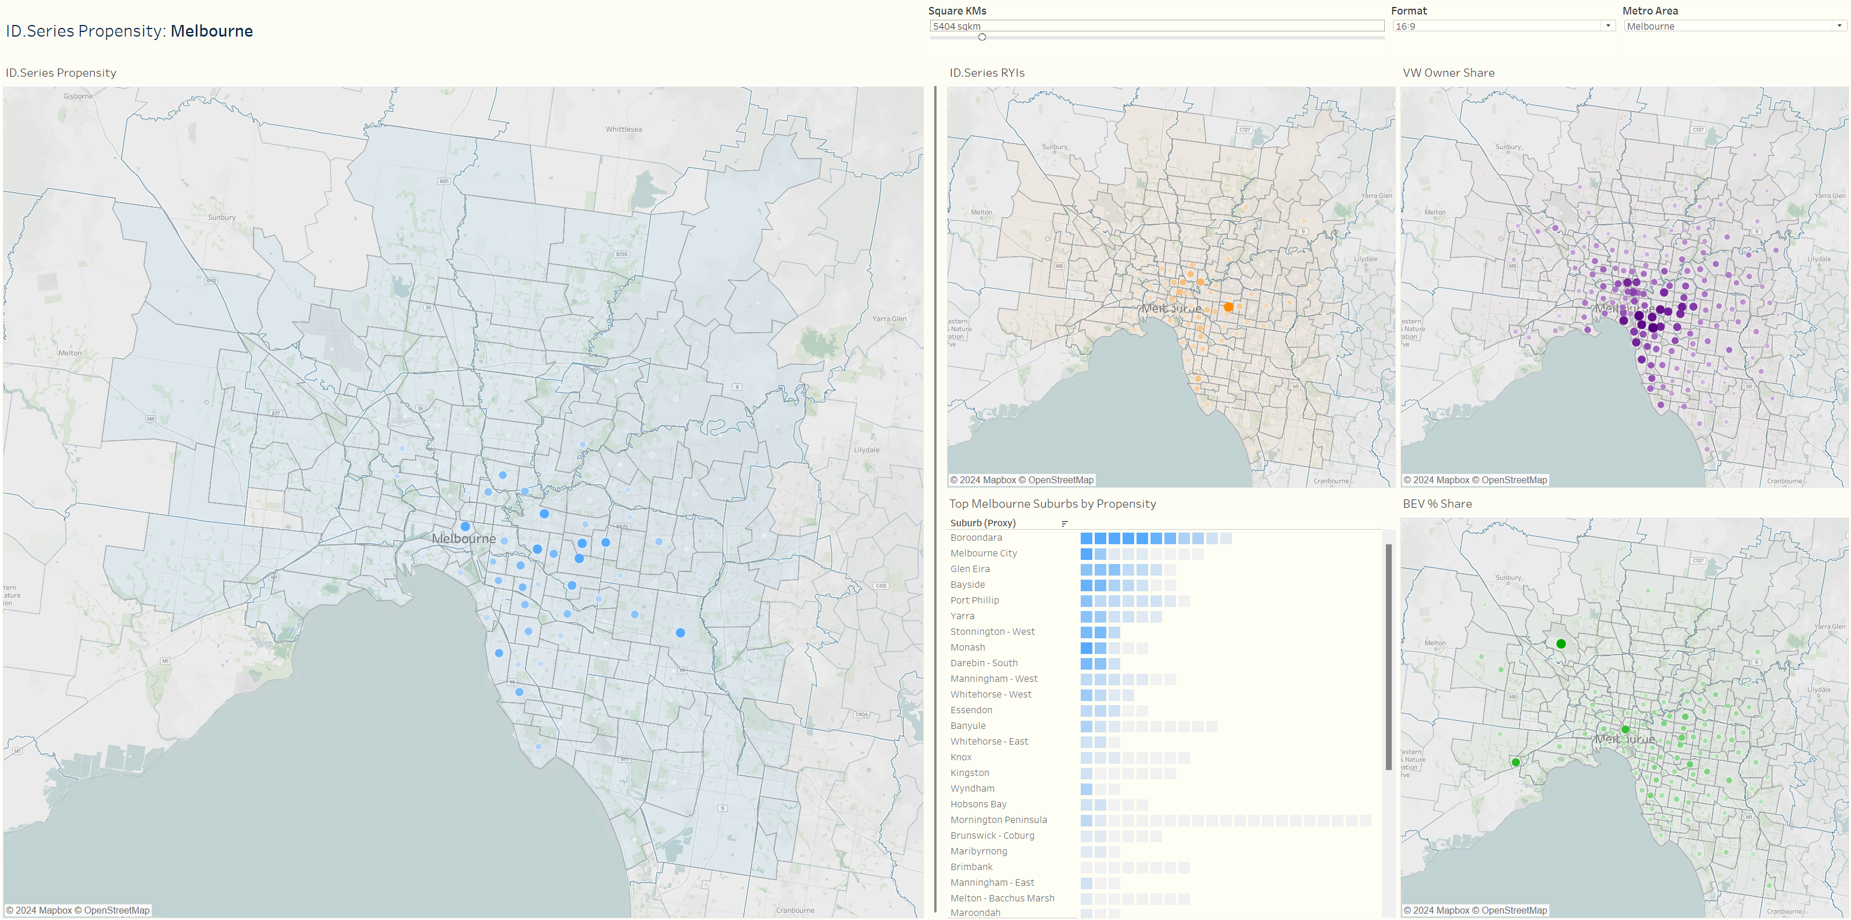
Melbourne
N.B. All scales represent positive relationship between size/color intensity and metric. For individual metro areas, scales are relative to other suburbs in the same metro area only

Slide 34
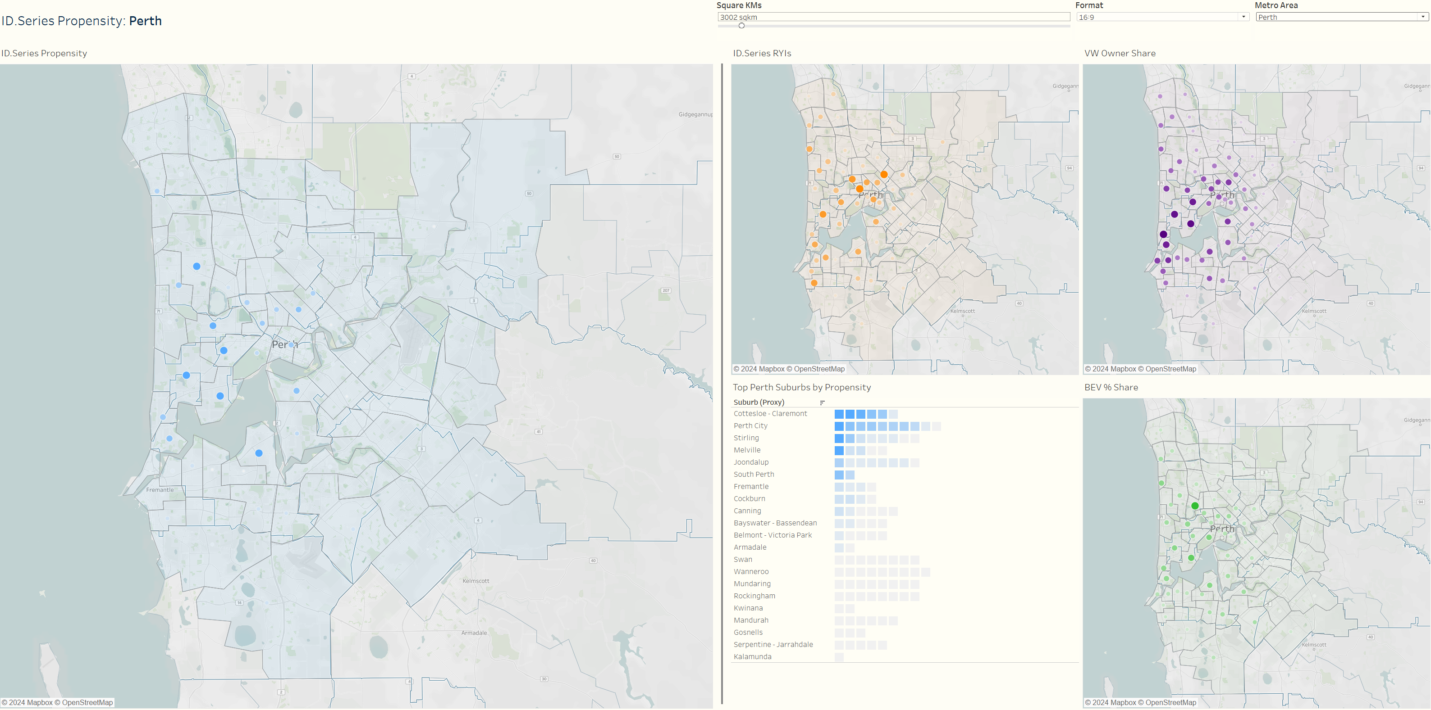
Perth
N.B. All scales represent positive relationship between size/color intensity and metric. For individual metro areas, scales are relative to other suburbs in the same metro area only

Slide 35
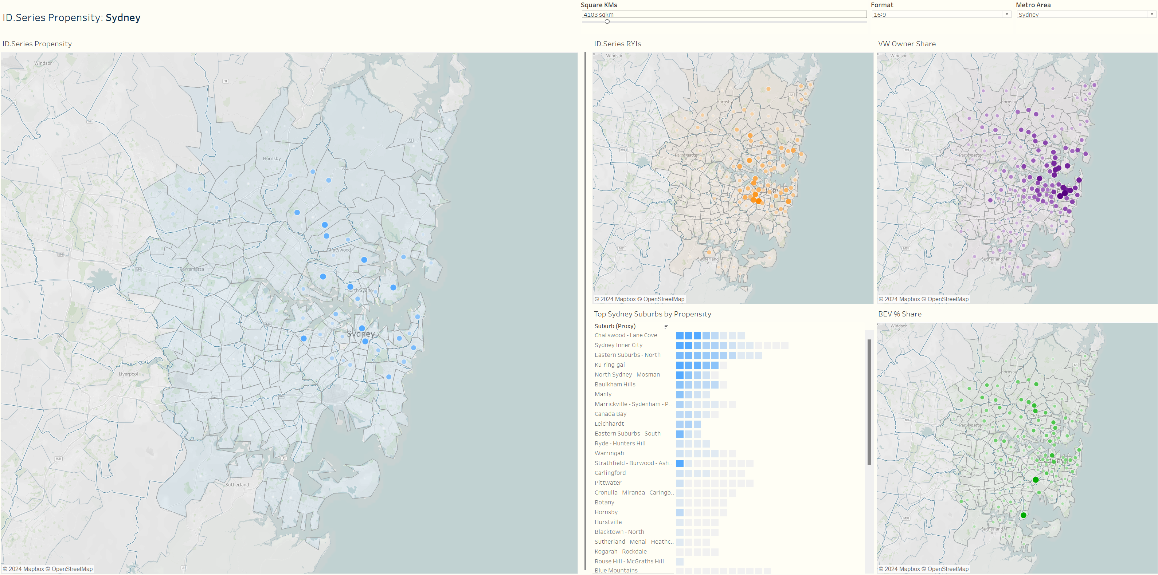
Sydney
N.B. All scales represent positive relationship between size/color intensity and metric. For individual metro areas, scales are relative to other suburbs in the same metro area only

Slide 36
Appendices
DOCUMENTATION

Slide 37
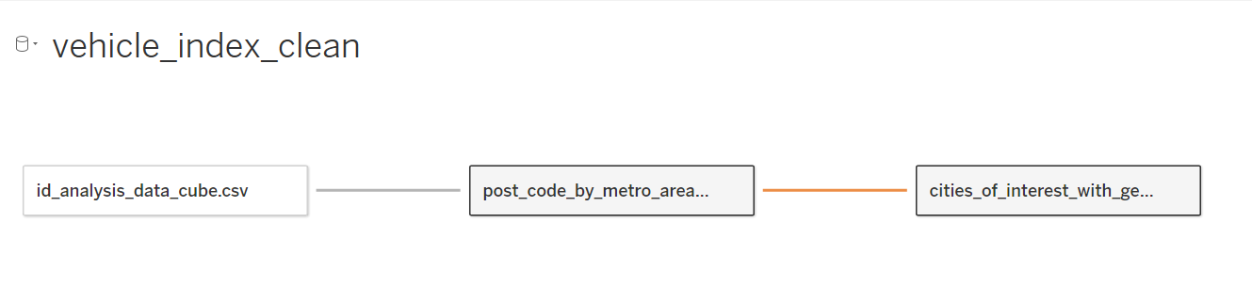
Our Data Structure
The final data structure in Tableau consists of three files:
TABLE | DETAIL
Primary data cube | At postcode, fueltype, year level: Light vehicles (LVs) VW ownerships ID.4 and ID.5 RYIs Note that only LVs data exists at fueltype and year level
Geography lookup | Helps us match postcodes to suburbs (note the cardinality of this relationship is many to many – a postcode can intersect multiple suburbs, and vice-versa)
City of interest lookup | Used for identifying centroids of different metropolitan areas
37

Slide 38
Field | Example | Description
State | NSW | State that postcode resides
Postcode | 2040 | 4 digit postcode
Year | 2023 | Year that data was collected
Fuel Type | BEV | Type of fuel that vehicle data refers to
LVs | 68 | Count of light vehicles for that postcode, year, and fueltype
VWs | 0 | Count of unique Volkswagen Ownerships (past and present) in that Postcode (2023, ICE only)
RYIs | 17 | Count of unique “Registrations of interest” for the ID Series for that postcode and fueltype (2023 only)
Latitude | -33.8759 | Latitude for postcode centroid
Longitude | 151.1587 | Longitude for postcode centroid
Field | Example | Description
POA_CODE_2021 | 3161 | Postcode
SA3_CODE_2021 | 20802 | Suburb code
SA3_NAME_2021 | Glen Eira | Suburb name
GCCSA_NAME_2021 | Greater Melbourne | Region name
METRO_AREA | Greater Melbourne | Cleaned version of GCCSA_NAME_2021
Field | Example | Description
Metro Area | Greater Perth | Join key to metro_area
City | Perth | City name
Centre Latitude | -31.9559 | Tableau generated city centroid latitude
Centre Longitude | 115.8606 | Tableau generated city centroid longitude
Point Order | 1 | Dummy variable

Slide 39

Thank you
39

